Slide 1
Vernier Caliper
A Vernier caliper is a device to measure the size of small objects of the size
ranging from a few millimeters to a few centimeters.
This is one of the first few instruments science students start using in the lab.
This video is for these students to enable understanding the basic principles.

Slide 2
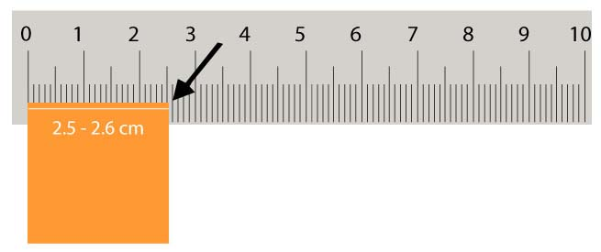
Limitation of measuring the size with a ruler
Suppose it is required to measure the width of a square. With a ruler
we find that the width is greater than 2.5 cm but less than 2.6 cm. In
order to improve the accuracy of measurement, Pierre Vernier of
France in 1631 introduced an additional sliding scale to the main scale.
This unit called Vernier caliper dramatically yet in a simple manner
improved the accuracy of measurement by at least a factor of 10.

Slide 3
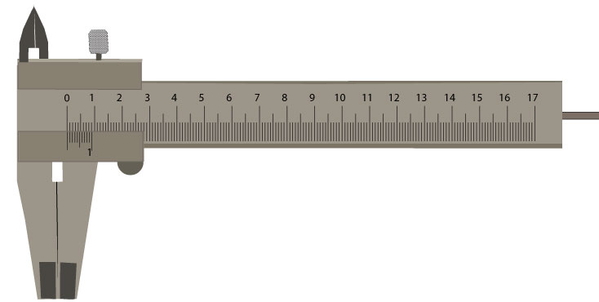
The components of the Vernier caliper are shown in the figure.
Upper jaws
Tightening screw
Fixed Main scale
Sliding Vernier scale
Lower jaws
When the jaws are closed the zero of the main scale and the Vernier scale coincide.

Slide 4
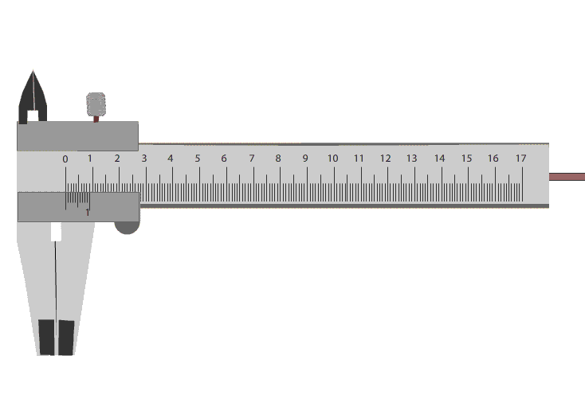
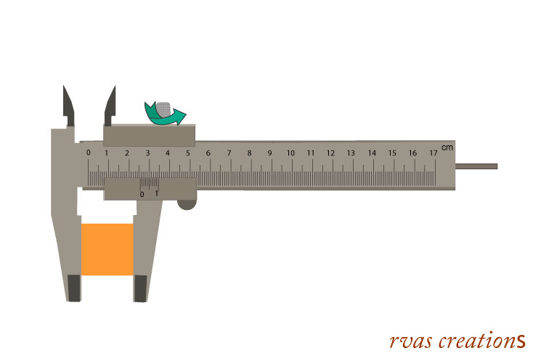
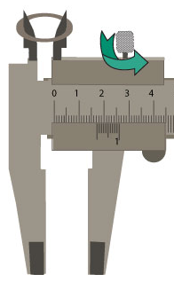
One of the jaws is movable to accommodate the object
To measure the Inner diameter
the object is placed between the
upper jaws
The object is kept
between the lower
jaws for outer
diameter/size

Slide 5
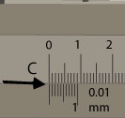
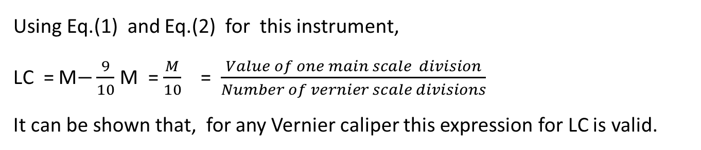
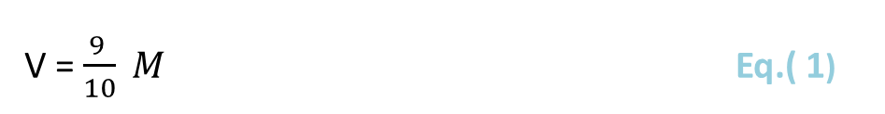
The least count depends on the number of
divisions on the Vernier scale and the size of each division. For the instrument in Fig.:
Least count of the Vernier caliper:
10 Div. of Vernier scale (V) = 9 Div. of main scale (M)
V = $\frac{9 }{10} M$ Eq.( 1)
As M = 0.1 cm
V = 0.09 cm
The least count (LC) of a Vernier caliper is defined as
= 1 main scale division – 1 Vernier scale division
= M – V = 0.01 cm Eq. (2)
Using Eq.(1) and Eq.(2) for this instrument,
LC = M$−\frac{9}{10}$ M = $\frac{M}{10}$ = $\frac{Value of one main scale division}{Number of vernier scale divisions}$
It can be shown that, for any Vernier caliper this expression for LC is valid.
Eq. (3)
Note that the definition of least count by Eq. 2 and Eq. 3 are equivalent.

Slide 6

To measure the size of an object:
1. Place the object between the jaws and tighten the screw.
When the jaws were closed, zero of main
scale and Vernier scale coincided.
Hence the size of the object is given by the new distance between these two zero points.
2. Read the main scale reading (MS) just before the zero of Vernier scale. In this case it is 2.5 cm.
3. Check which Vernier division is coinciding with one of the main scale divisions. In this case 5th division is coinciding with one of the main scale divisions.
size = MS reading + (coinciding Vernier division) X (LC)
= 2.5 + 5 X .01
= 2.55 cm

Slide 7


Theory:
The zeros of Main
and Vernier scales
coincided when the
jaws were closed.
With the object
between the jaws,
its size will be the
new distance
between the two
Zero marks :
FB or FD
Size
C
F
B
A
D
E
Size = FB = FA + AB = FA + (AC–BC)
= FA + (AC –DE) = FA + (5M –5V)
= FA + 5 x (LC)
= Main scale reading + (coinciding Vernier division) x (Least count)
This is precisely the equation we used earlier.

Slide 8
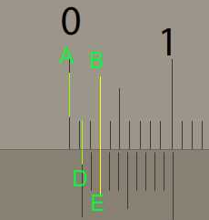
Zero error
In the previous section we saw that the size of the object between the jaws is
equal to the distance between the positions of the zero points of main and Vernier
scales. It was assumed that when the jaws were closed the zero points coincided.
That is, the instrument has no ‟zero error”. In case the two zero points do not
coincide, the instrument is said to have a zero error. The zero error can be positive
or negative.
.
The zero error is positive when the zero point on the
Vernier scale is ahead of the zero on the main scale.
The zero error needs to be determined and applied
to the measured size estimate. For this, determine
the coinciding Vernier division. It is 2nd in this case.
Positive zero error
In the figure the zero point (D) of Vernier scale is
ahead of that of the mains scale (A) by distance =‟AD”.
Hence the positive zero error = AD
= AB-DE
= 3M-2V
= 3 x 0.1 – 2 x .09
= 0.12 cm

Slide 9
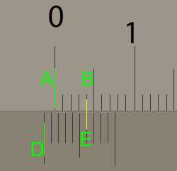
Negative zero error
The zero error is negative if the zero point on the
Vernier scale is before the zero on the main scale .
The zero error needs to be estimated and applied to
the measured size estimate. For this, determine the
coinciding Vernier division. It is 6th in this case.
Using the same expression as for the positive
zero error,
Zero error = distance of zero of Vernier scale
from zero of main scale
= AD
= AB-DE
= 4M-6V
= 4 x 0.1– 6 x 0.09
= 0.4– 0.54
= – 0.14 cm
In both cases , the general expression for correction is
True size = measured size – zero error
Measured size > true size for positive zero error
Measured size < true size for negative zero error

Slide 10
The method to determine the inner diameter of a hollow cylinder or a ring is the
same. The object in this case is supported between the upper jaws.
The least count of the Vernier caliper determines the theoretical accuracy with
which the measurements can be made. The more the number of divisions on the
Vernier scale the least count will have a smaller value and the measurements
more accurate.
In practice, the measurements may have random and systematic errors. If
one makes several measurements of the same object, the measured values may
show small differences. In case of measurement with the Vernier caliper, the
random error for example may be associated with the uncertainty in judging the
coinciding Vernier division. For a simplistic approach, an average of all the
measurements may be taken to be closest to the actual value.
A more detailed analysis of the errors and their treatment will be taken up in
a future blog.

